Slide 1
SQL via sqlite

Slide 2
SQL
We'll cover some of the basics of SQL (structured querry language) by working through some examples
SQL is a set of language standards for databases
As its name implies, sqlite is a small implementation of SQL.
Here's a tutorial on installing for windows. (Sqlite3 is a single file.)
For a Mac/linux install in the usual way

Slide 3
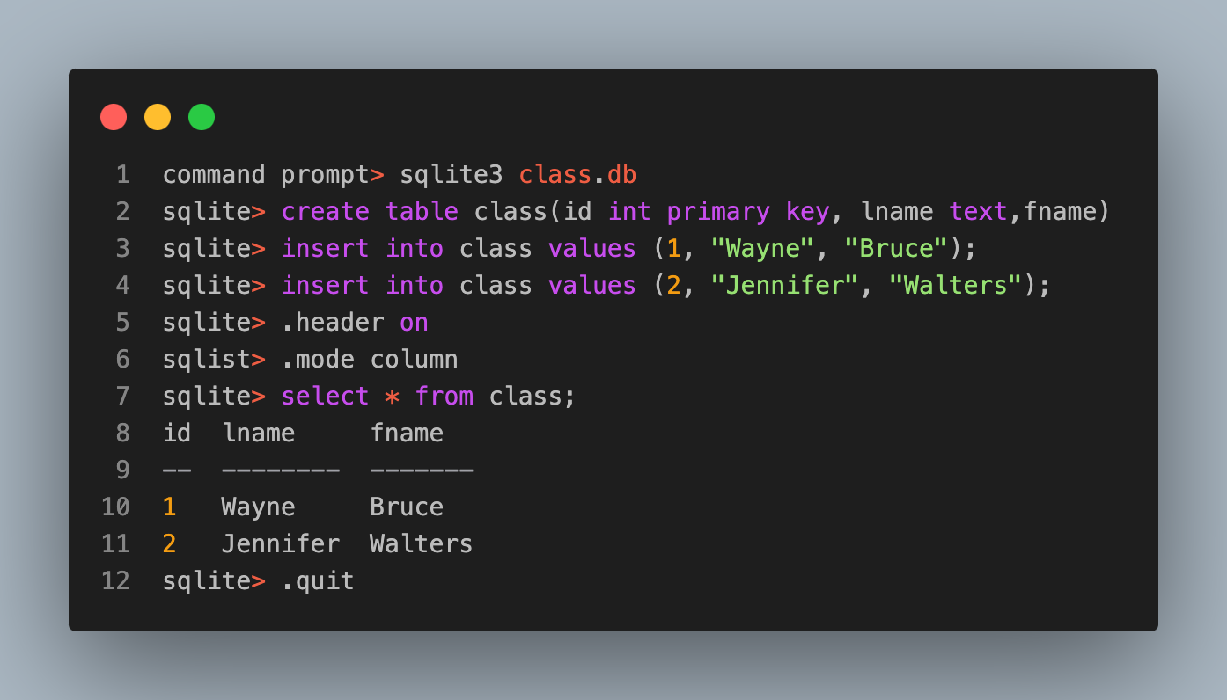
Creating a database

Slide 4
The command sqlite3 class.db opens up the database, in this case creating a new one, and then enters into the sqlite command line.
The command create ... creates our table within our database
The insert ... commands insert two records
The .header ... and .mode ... commands format output
The select ... command grabs all records
Then .quit just quits the command line.
ls in the current working directory now shows the file class.db
Everything else we discuss below assumes working in the sqlite command prompt.

Slide 5
Working in sqlite
It's nice to work with a development environment specifically created for sql with nice highlighting and auto completion
Sqlite has
SQL commands, which must be typed with a semicolon at the end
sqlite specific commands, which begin with a period +pragma commands, which are also sqlite specific
Some things will be portable to other SQL implementations and others not

Slide 6
A more realistic example
Consider the data Opioids in the US at Open Case Studies
https://github.com/opencasestudies/ocs-bp-opioid-rural-urban
It's described here

Slide 7
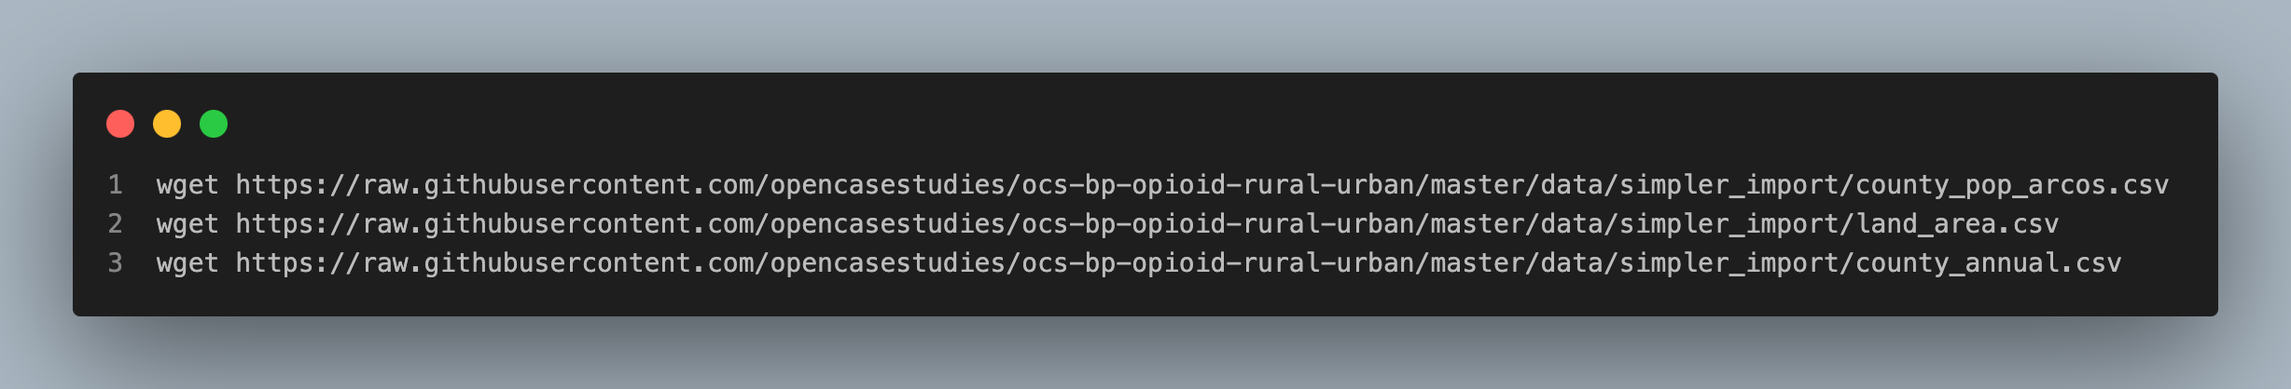
Downloading the data

Slide 8
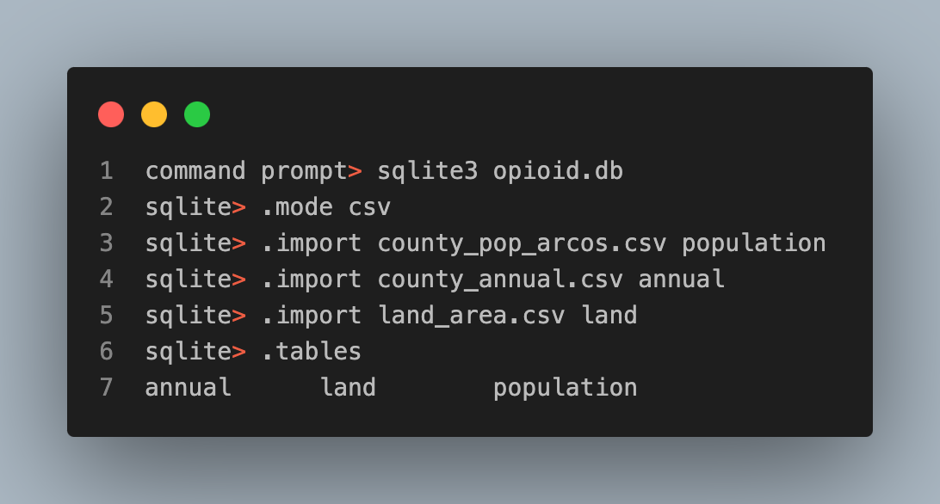
Importing into sqlite

Slide 9
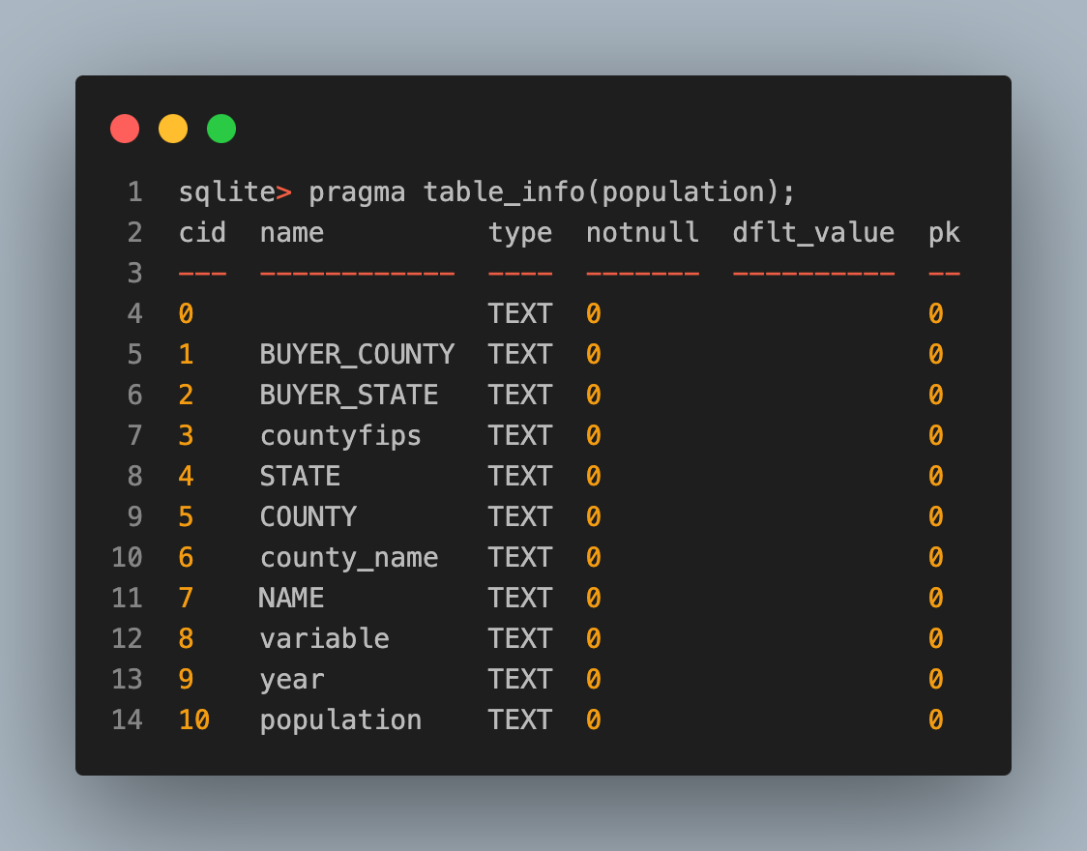
What variables do the tables include?

Slide 10
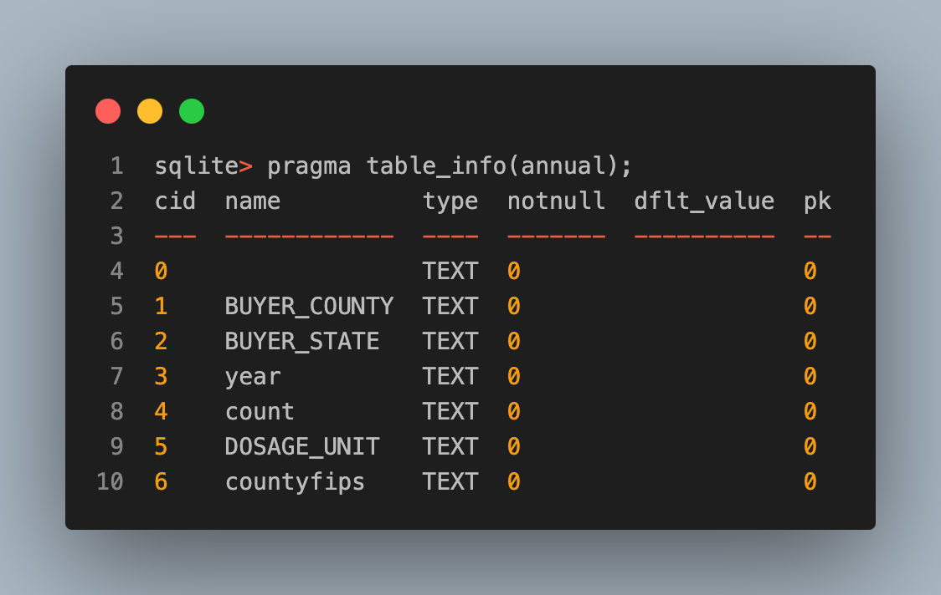
What variables do the tables include? continued

Slide 11
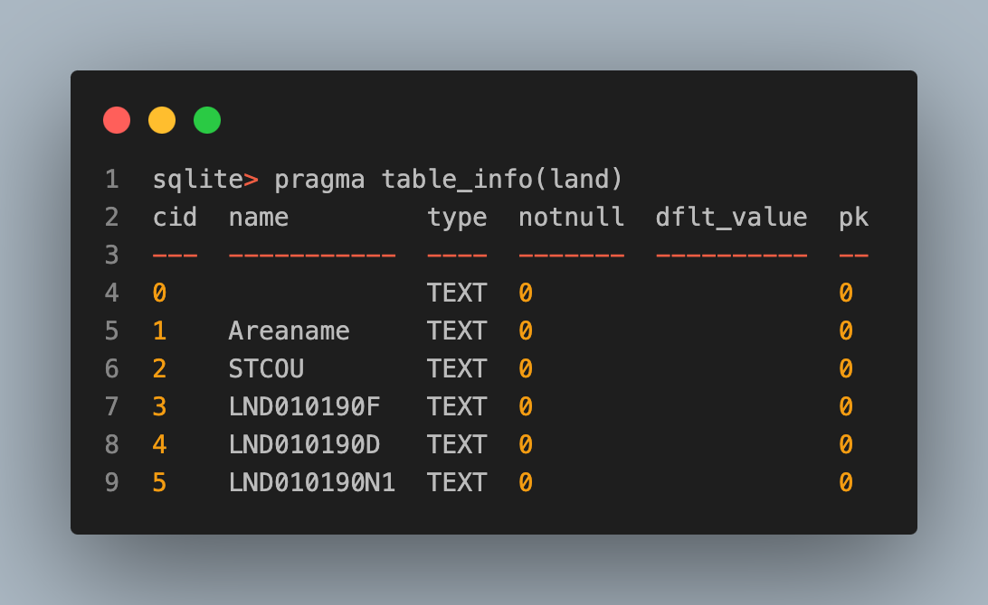
What variables do the tables include? continued

Slide 12
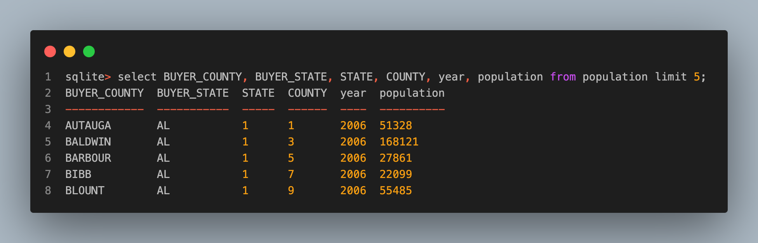
Working with data
printing out columns
limit 5 prints out five rows

Slide 13
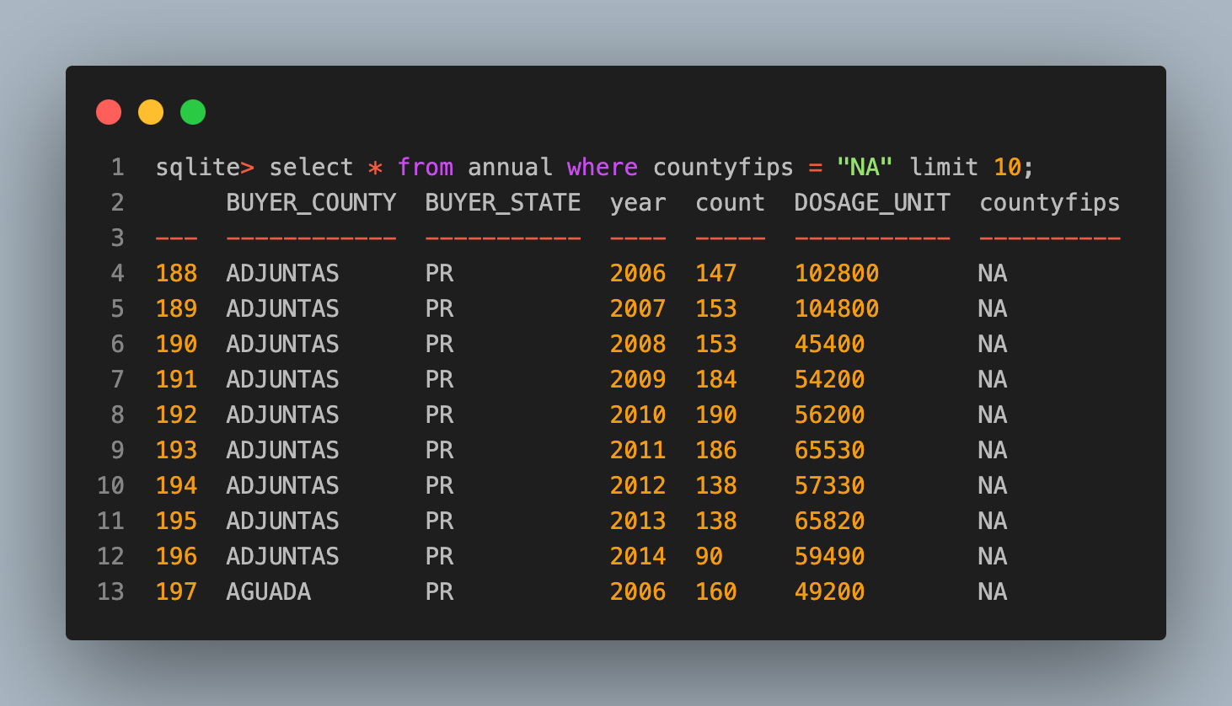
Working with the data
Let's perform some of the tasks in the write up
Goal is to print out some of the missing data in the annual dataset.
Here, we used the condition "NA" to test for missingness, since the CSV files have the string NA values for missing data.

Slide 14
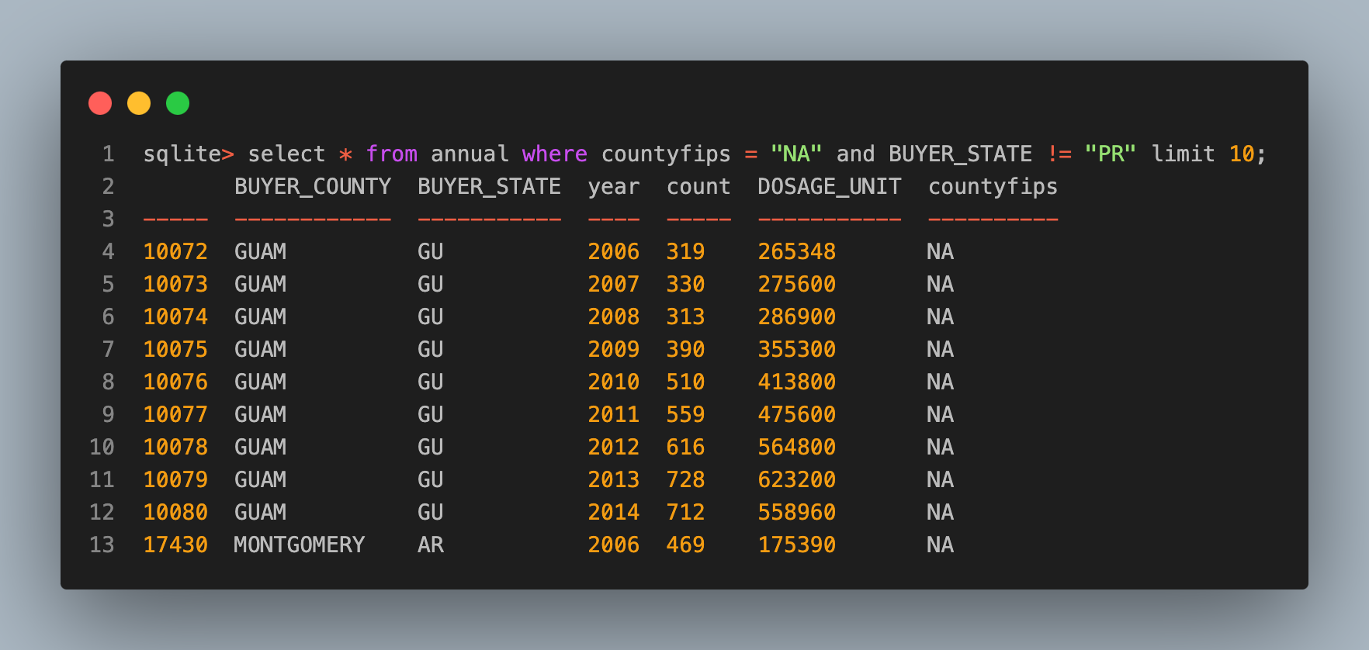
Working with the data continued
Is there missing data outside of PR?
Further inspect the missing data further on your own.
It looks like its the unincorporated territories and a handful of Arkansas values missing countyfips
Montgomery county AR is missing FIPs codes.

Slide 15
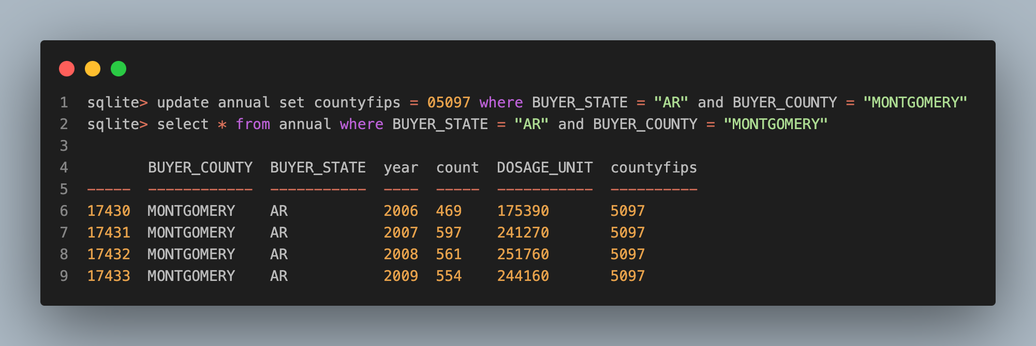
Working with the data continued
Since we want to look US states in specific, we set the Montgomery county ones to the correct value 05097 and ignore the other missing values.

Slide 16
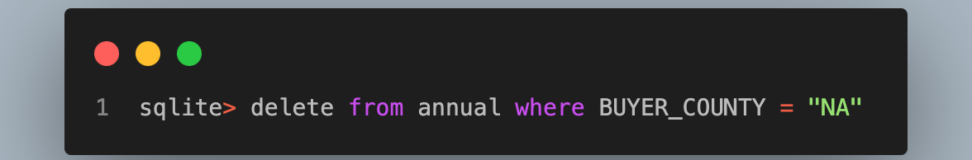
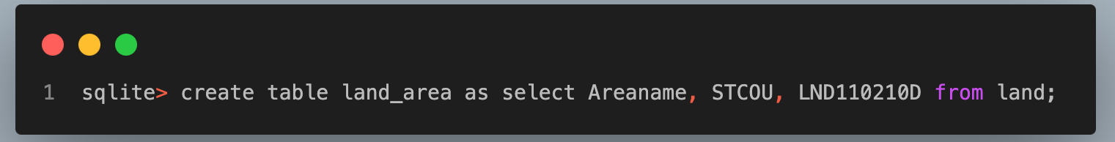
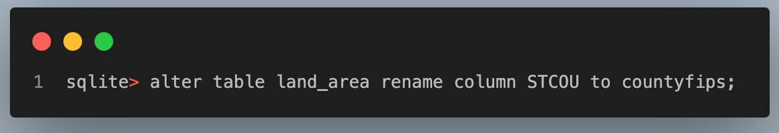
Working with the data continued
Lets delete rows from the annual table that have missing county data.
(HW) Check on these counties before and verify that they've been deleted afterwards.
We want to grab just three columns from the land table, so let's create a new one called land_area.
Also, the column there is called STCOU, which we want to rename to countyfips.

Slide 17
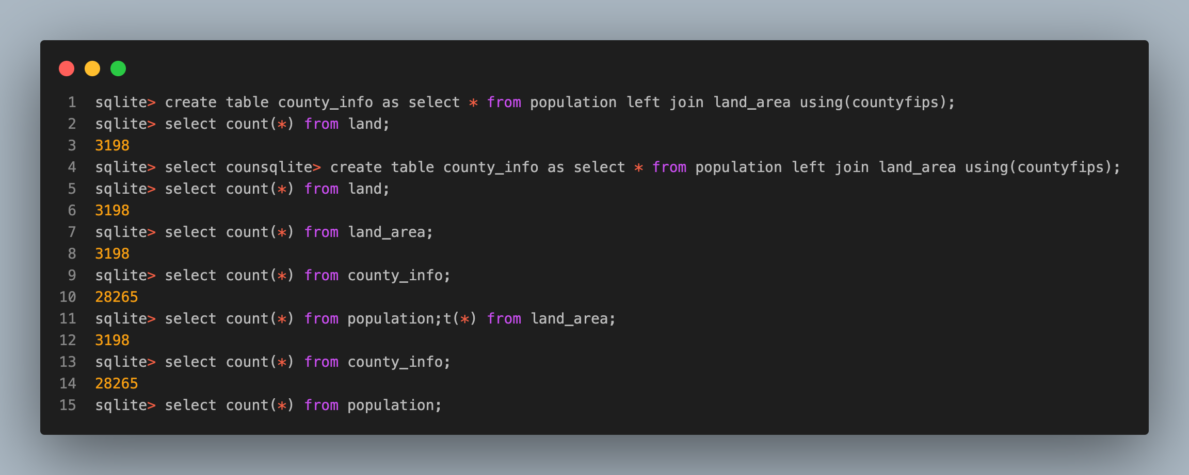
Working with the data continued
Next we want to start joining the tables
So let's left join our table and print out the counts to make sure we accounted correctly.

